Slide 1
Local Search II

Slide 2
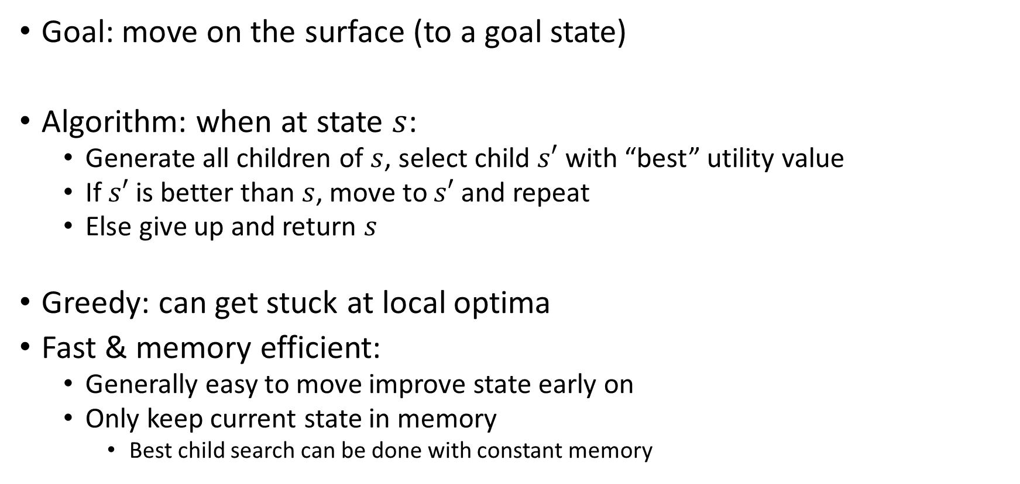
Hill Climbing
Goal: move on the surface (to a goal state)
Algorithm: when at state $s$:
Generate all children of $s$, select child $s′$ with “best” utility value
If $s′$ is better than $s$, move to $s′$ and repeat
Else give up and return $s$
Greedy: can get stuck at local optima
Fast & memory efficient:
Generally easy to move improve state early on
Only keep current state in memory
Best child search can be done with constant memory

Slide 3
Hill Climbing
Problem: what happens if we reach a plateau?
Hill Climbing will exit.
Allow “sideways” move on plateaus
Accomplished with thresholding (how to choose)
Accomplished probabilistically (flip a weighted coin)
Probability of moving can depend on “steepness” of hill before plateau
A version of momentum!
Random restarts: run multiple independent hill-climbers
Different random initializations → different trajectories
Return the “best” solution amongst trials

Slide 4
Simulated Annealing
When should we go in “bad” directions?
Short term loss can lead to long term gain
Hill climbing → always go in a “good” direction
Simulated Annealing:
Modify hill climbing
Instead of picking the best move, pick a move at random (a candidate)
If candidate is good, accept it (and repeat)
If candidate is not good, accept with some probability, otherwise repeat
Scale prob of accepting a bad move as function of time

Slide 5
Local Search In Continuous Spaces
So far, algorithms proposed bad for continuous spaces
(GA for model parameters works on continuous spaces)
Problem: enumerating child states
Potential infinite!
Can still measure “good” and “bad” states
Calculus not enumeration

Slide 6
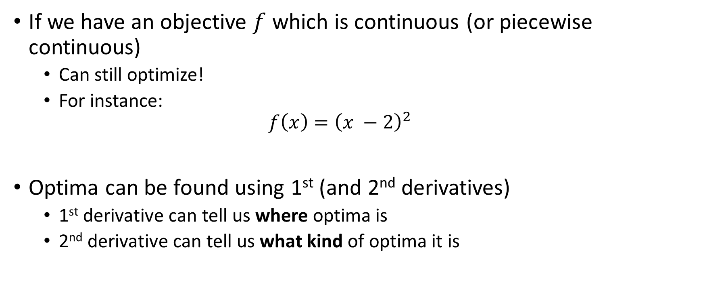
Derivatives
If we have an objective $f$ which is continuous (or piecewise continuous)
Can still optimize!
For instance:
$$f\left(x\right)={\left(x −2\right)}^{2}$$
Optima can be found using 1st (and 2nd derivatives)
1st derivative can tell us where optima is
2nd derivative can tell us what kind of optima it is

Slide 7
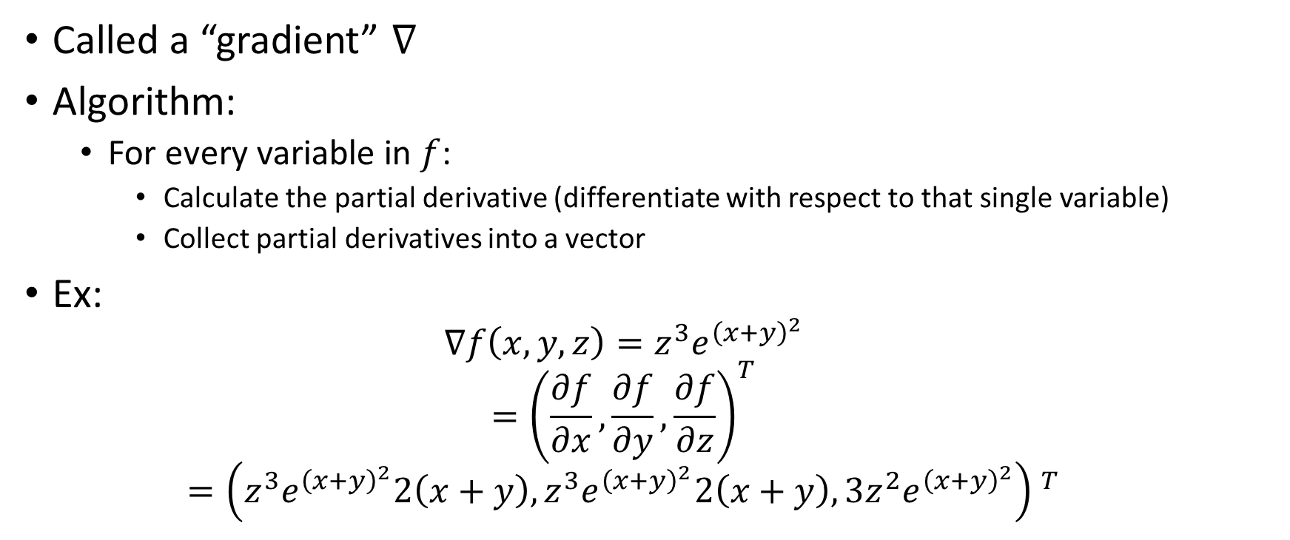
Derivatives in Higher Dimensions
Called a “gradient” $∇$
Algorithm:
For every variable in $f$:
Calculate the partial derivative (differentiate with respect to that single variable)
Collect partial derivatives into a vector
Ex:
$$∇f\left(x,y,z\right)={z^{3}e}^{{\left(x+y\right)}^{2}}$$
$$={\left(\frac{∂f}{∂x},\frac{∂f}{∂y},\frac{∂f}{∂z}\right)}^{T}$$
$$={\left(z^{3}e^{{\left(x+y\right)}^{2}}2\left(x+y\right),z^{3}e^{{\left(x+y\right)}^{2}}2\left(x+y\right), 3z^{2}e^{{\left(x+y\right)}^{2}}\right) }^{T}$$

Slide 8
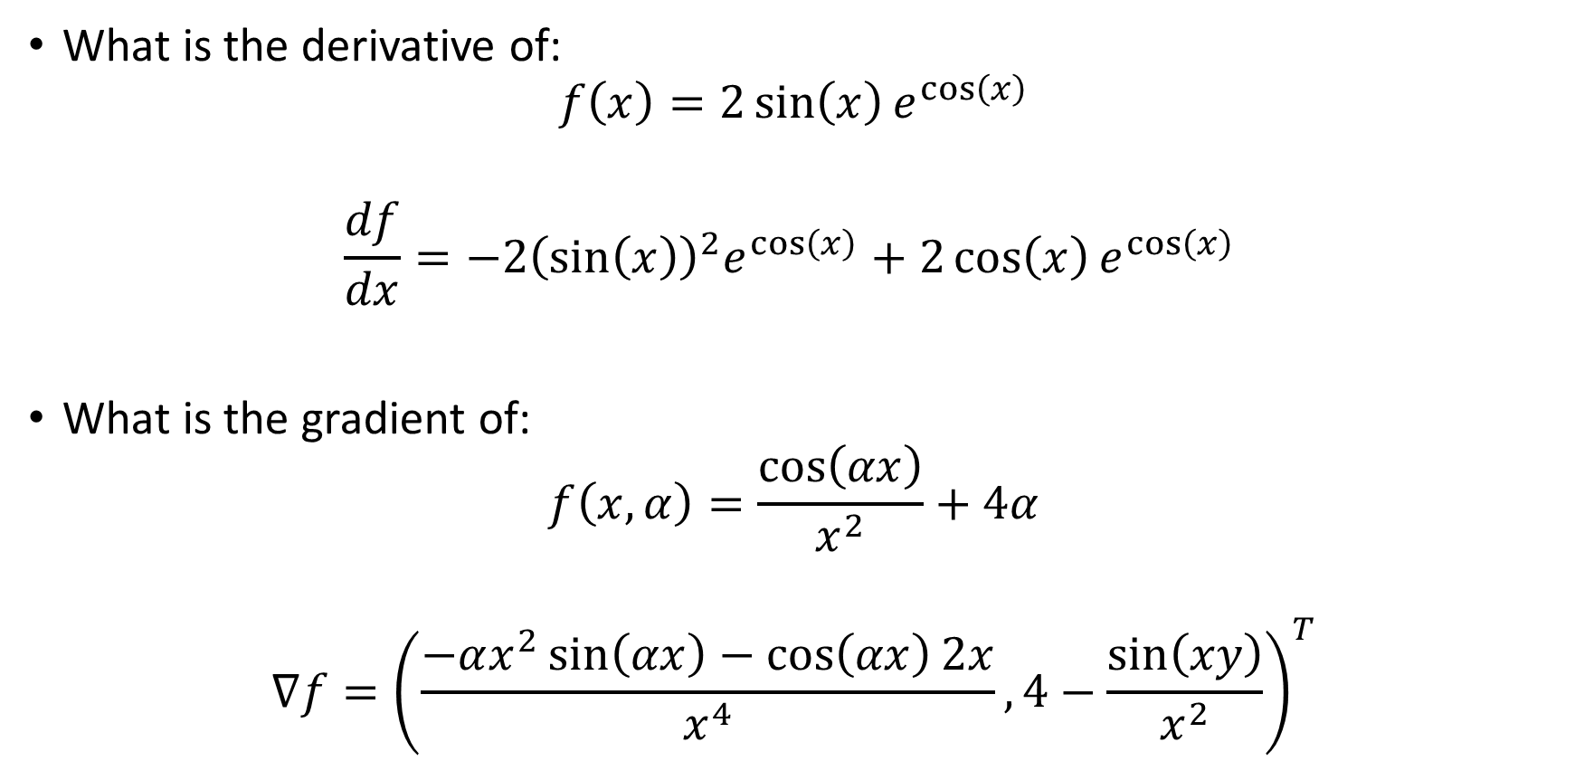
Derivative & Gradient Practice
What is the derivative of:
$$f\left(x\right)=2\sin\left(x\right)e^{\cos\left(x\right)}$$
$$\frac{df}{dx}=−2{\left(\sin\left(x\right)\right)}^{2}e^{\cos\left(x\right)}+2\cos\left(x\right)e^{\cos\left(x\right) }$$
What is the gradient of:
$$f\left(x,α\right)=\frac{\cos\left(αx\right)}{x^{2}}+4α$$
$$∇f={\left(\frac{−αx^{2}\sin\left(αx\right)−\cos\left(αx\right)2x}{x^{4}}, 4−\frac{\sin\left(xy\right)}{x^{2}}\right)}^{T}$$

Slide 9
Derivatives & Gradients
Sometimes:
We can set the derivative to 0 and solve (rare!)
Formula we get is called a closed form solution
Super super super super super rare
What if we can’t get a closed form solution?
Derivative + gradient always points towards local maximums
Continuous hill climbing?
Called gradient descent/ascent

Slide 10
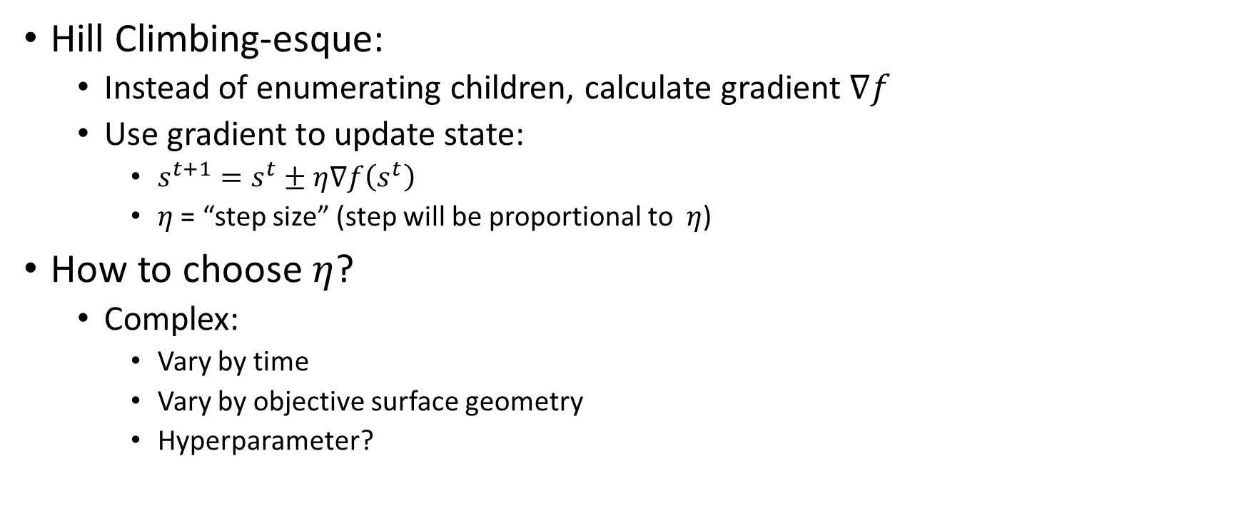
Gradient Descent/Ascent
Hill Climbing-esque:
Instead of enumerating children, calculate gradient $∇f$
Use gradient to update state:
$s^{t+1}=s^{t}±η∇f\left(s^{t}\right)$
$η$ = “step size” (step will be proportional to $η$)
How to choose $η$?
Complex:
Vary by time
Vary by objective surface geometry
Hyperparameter?

Slide 11

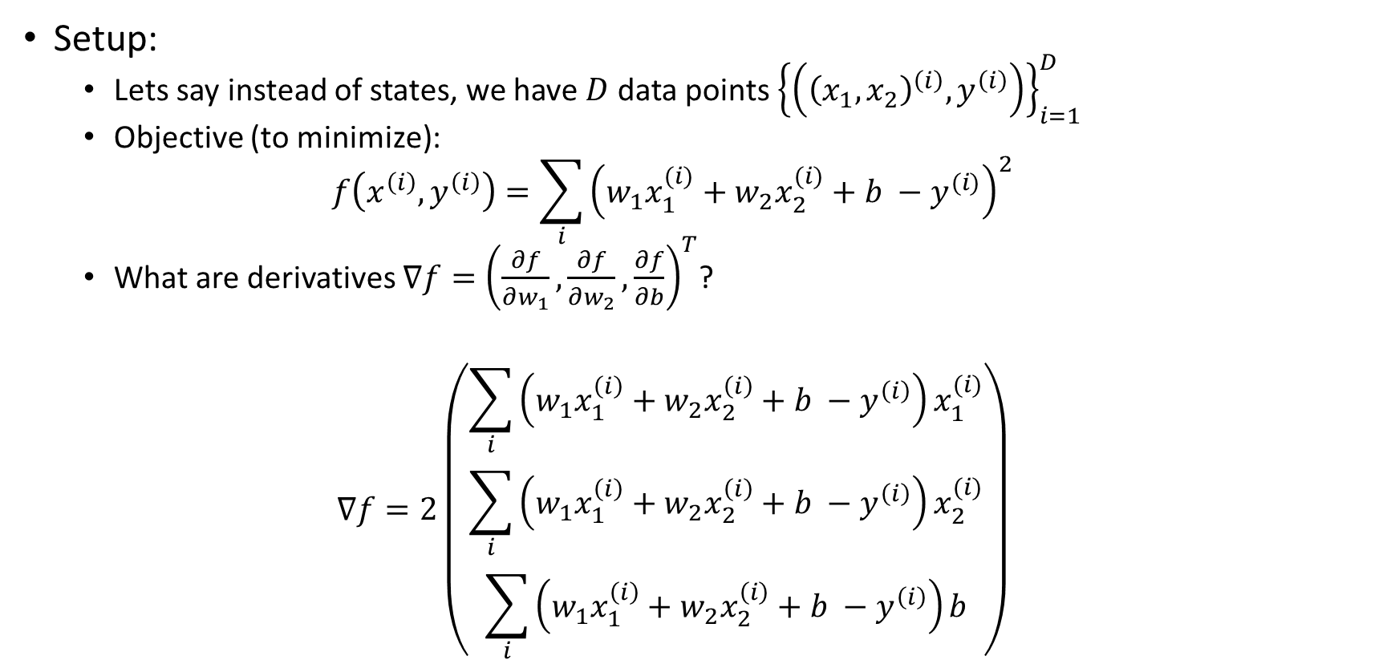


Gradient Practice
Setup:
Lets say instead of states, we have $D$ data points ${\left\{\left({\left(x_{1}, x_{2}\right)}^{\left(i\right)}, y^{\left(i\right)}\right)\right\}}_{i=1}^{D}$
Objective (to minimize):
$$f\left(x^{\left(i\right)}, y^{\left(i\right)}\right)=\sum_{i}{{\left(w_{1}x_{1}^{(i)}+w_{2}x_{2}^{(i)}+b −y^{(i)}\right)}^{2}}$$
What are derivatives $∇f={\left(\frac{∂f}{∂w_{1}},\frac{∂f}{∂w_{2}},\frac{∂f}{∂b}\right)}^{T}$?
$$∇f=2\left(\begin{aligned}\sum_{i}{\left(w_{1}x_{1}^{\left(i\right)}+w_{2}x_{2}^{\left(i\right)}+b −y^{\left(i\right)}\right)x_{1}^{(i)}} \\ \begin{aligned}\sum_{i}{\left(w_{1}x_{1}^{\left(i\right)}+w_{2}x_{2}^{\left(i\right)}+b −y^{\left(i\right)}\right)x_{2}^{(i)}} \\ \sum_{i}{\left(w_{1}x_{1}^{\left(i\right)}+w_{2}x_{2}^{\left(i\right)}+b −y^{\left(i\right)}\right)b}\end{aligned}\end{aligned}\right)$$
$$x_{1}$$
$$y$$
$$x_{2}$$

Slide 12

Newton-Raphson
Designed for finding the roots of equations
Nice! Want to find root of gradient!
In 1d:
$$s^{t+1}=s^{t}−\frac{f^{′}\left(s^{t}\right)}{f^{′′}\left(s^{t}\right)}$$
In higher dims:
$$s^{t+1}=s^{t}−H_{f}^{−1}\left(s^{t}\right)∇f\left(s^{t}\right)$$

